Slide 1
Literature Review
Ziyu Wu
Heyuan Liu
18 Oct. 2024

Slide 2
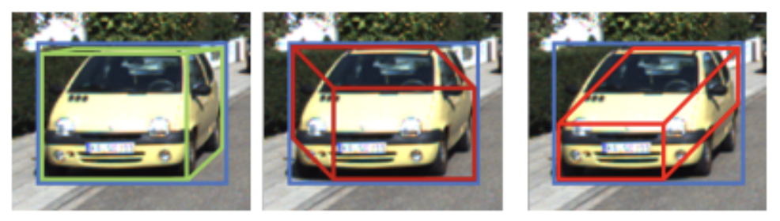
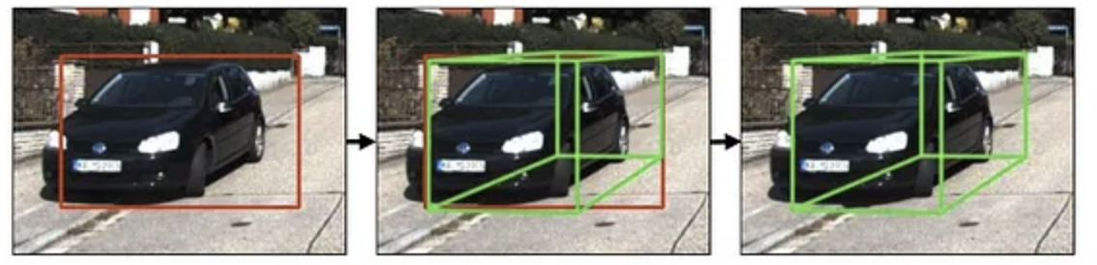
Deep3DBox (2017)
Recovering a 7-DOF from a 4-DOF Size (w, h), Position (x, y) --> Size (w, h, l), Position (x, y, z), Yaw
Use a deep neural network to predict 3D properties
3D properties + geometric constraints (2D bounding box) --> 3D bounding box
Mousavian, Arsalan, et al. "3d bounding box estimation using deep learning and geometry." Proceedings of the IEEE conference on Computer Vision and Pattern Recognition. 2017.

Slide 3
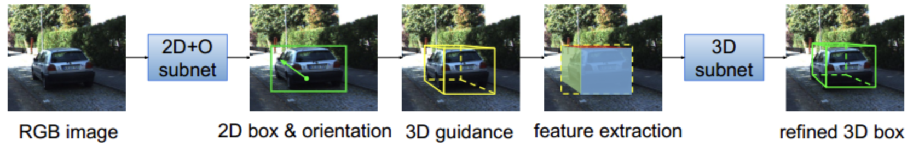
GS3D (2019)
Predict 2D detection box and yaw angle with CNN
Use the predicted results and prior knowledge (geometric constraints) to generate a rough 3D box, called guidance
Project the guidance onto the 2D image to extract the surface features
Use the features to fine-tune the 3D frame
Li, Buyu, et al. "Gs3d: An efficient 3d object detection framework for autonomous driving." Proceedings of the IEEE/CVF conference on computer vision and pattern recognition. 2019.

Slide 4
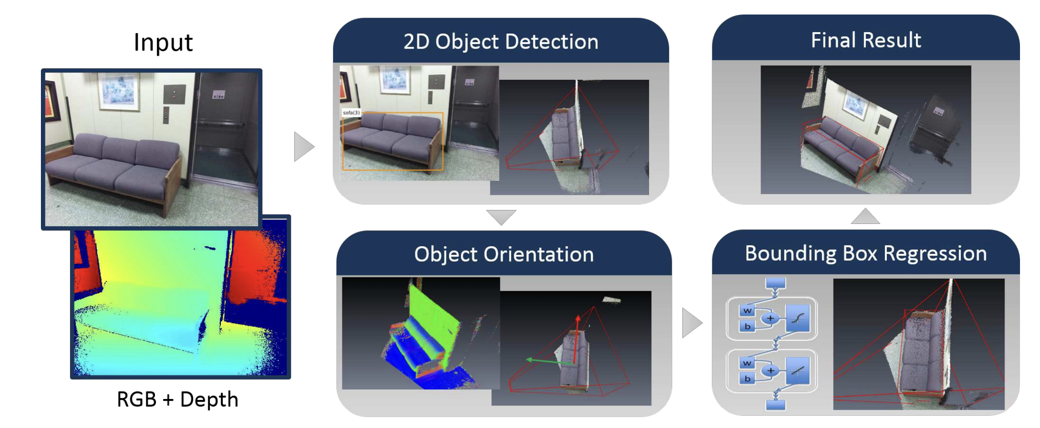
RGB-D 3D Detection (2017)
Use the Faster R-CNN model to detect 2D bounding boxes and generate frustum regions based on depth information
Estimate the rotation angle of the object using depth information
3D bounding box regression using MLP
Lahoud, Jean, and Bernard Ghanem. "2d-driven 3d object detection in rgb-d images." Proceedings of the IEEE international conference on computer vision. 2017.

Slide 5
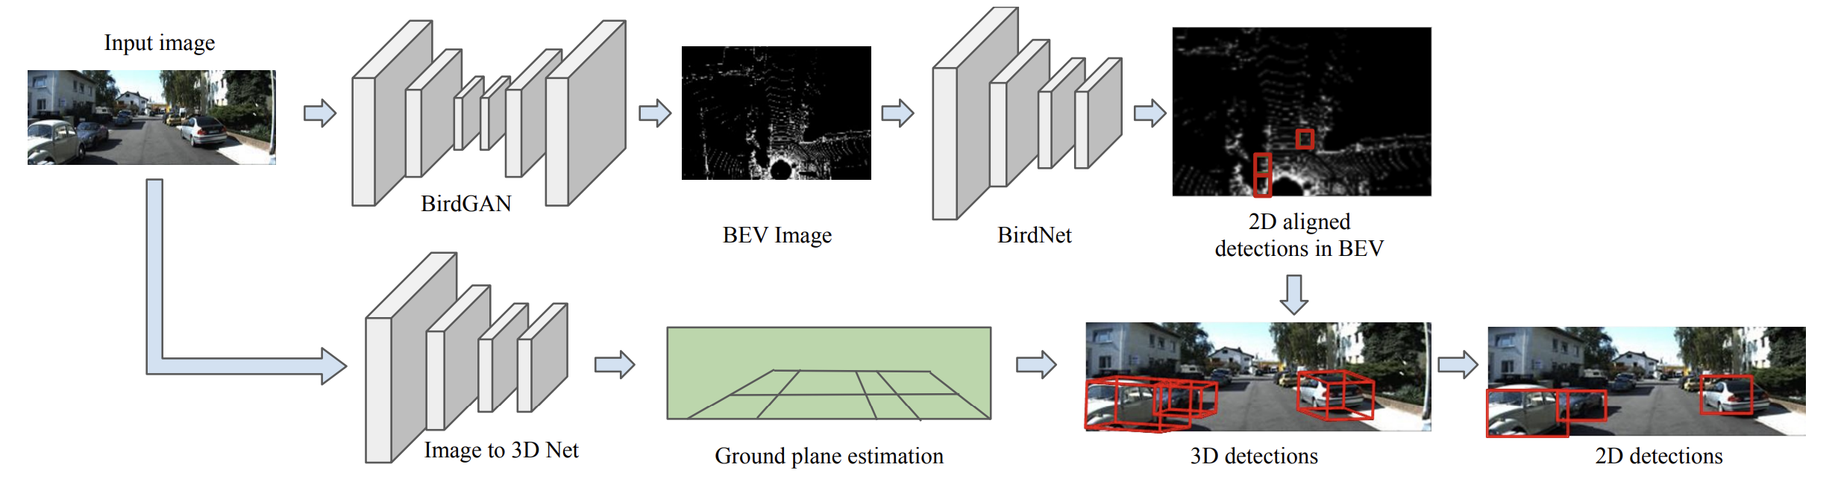
Bird 3D Detection (2019)
Generate bird's-eye view (BEV) from 2D monocular images using BirdGAN; 2D detection on BEV using BirdNet
CNN performs ground plane estimation and combines 2D detection in BEV to achieve 3D detection
Srivastava, Siddharth, Frederic Jurie, and Gaurav Sharma. "Learning 2d to 3d lifting for object detection in 3d for autonomous vehicles." 2019 IEEE/RSJ international conference on intelligent robots and systems (IROS). IEEE, 2019.

Slide 6
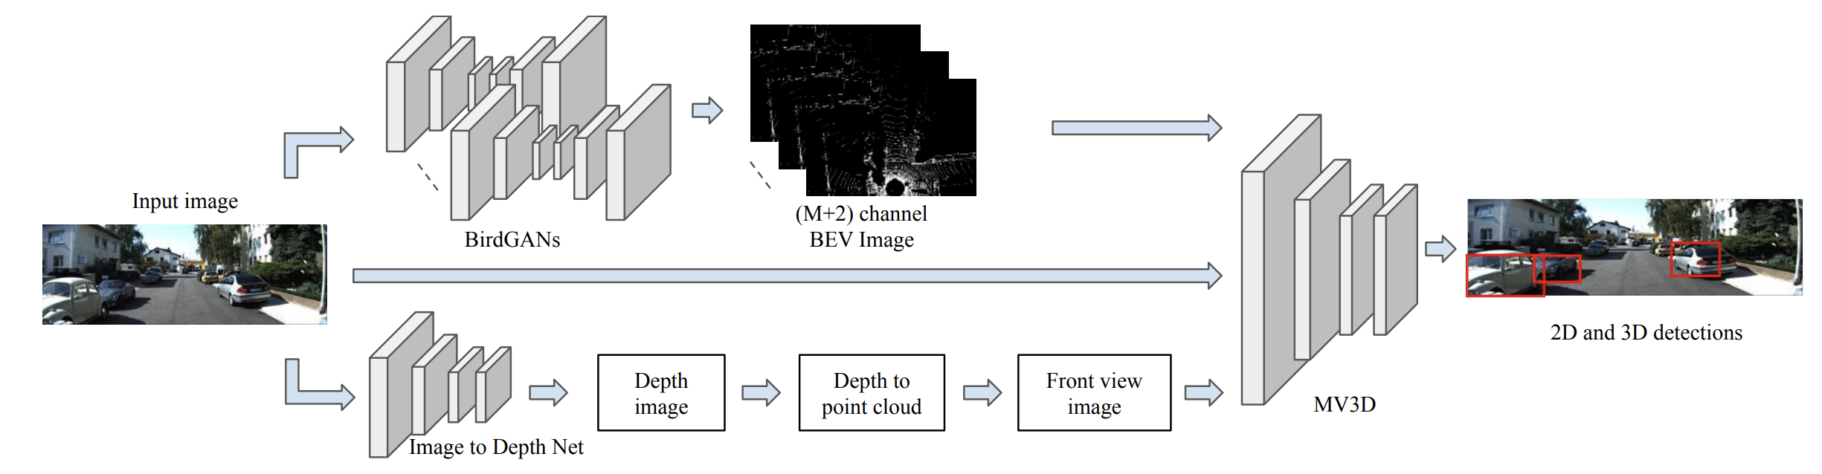
Bird 3D Detection (2019)
Generate a depth map from the RGB image, then generate a 3D point cloud from the depth map, and further generate a front view.
The RGB image, front view and generated BEV image are input into MV3D for 3D object detection.
Srivastava, Siddharth, Frederic Jurie, and Gaurav Sharma. "Learning 2d to 3d lifting for object detection in 3d for autonomous vehicles." 2019 IEEE/RSJ international conference on intelligent robots and systems (IROS). IEEE, 2019.

Slide 7
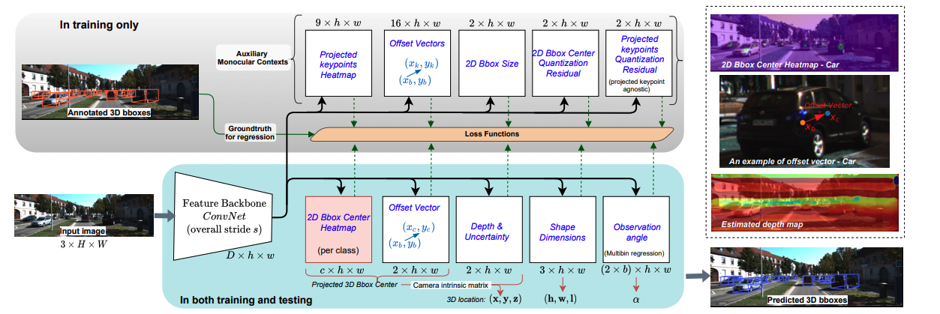
MonoCon (2022)
Works well in Single image tasks.
Auxiliary Learning (without information on depth)
1 Regression head for Learning on 3D boundary box, 1 for learning auxiliary features
Bring 2D features into training.
Liu, Xianpeng, Nan Xue, and Tianfu Wu. "Learning auxiliary monocular contexts helps monocular 3d object detection." Proceedings of the AAAI Conference on Artificial Intelligence. Vol. 36. No. 2. 2022.

Slide 8
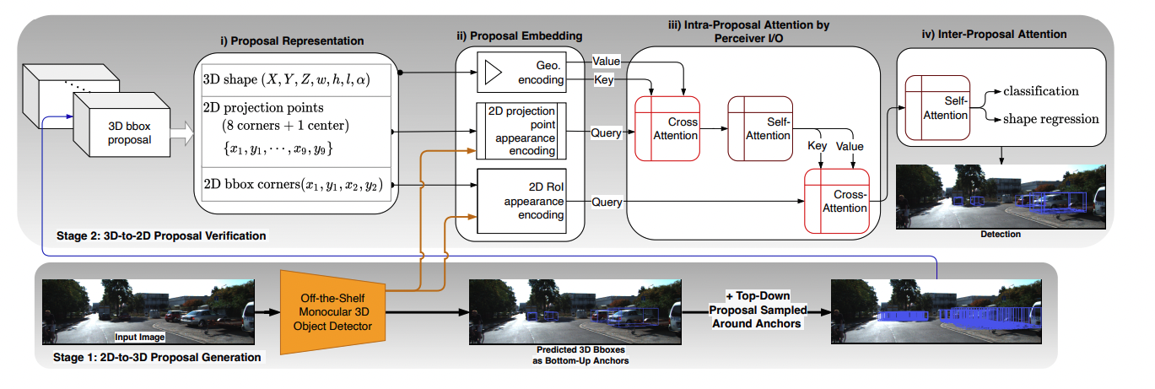
MonoXiver (2023)
Solve the Problem on Depth Ambiguity in Monocular Images.
local-grid search: sampling around the predicted 3D bounding boxes.
2d to 3d: generates 3D bounding boxes from 2D images using a bottom-up approach.
3d to 2d: refine the bounding boxes by verifying them using both geometric and appearance features.(Stage ii Perceiver I/O)
Liu, Xianpeng, et al. "Monocular 3d object detection with bounding box denoising in 3d by perceiver." Proceedings of the IEEE/CVF International Conference on Computer Vision. 2023.

Slide 9
3d Box from 2d
https://github.com/mgonzs13/yolov8_ros
2D Boundary detection from YoloV8
With Camera intrinsic parameters and Depth Value: 2D boundary box -> 3D boundary box

